Slide 1
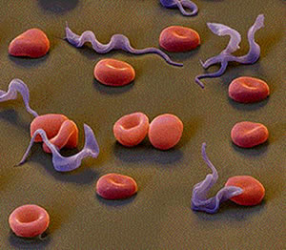
African Trypanosomiasis
Presented by Kristen Walter and Maggie Van Guilder

Slide 2
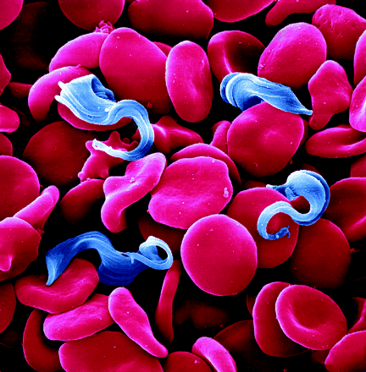
African Trypansomiasis
Outline
Disease background/mechanics
Vector
Impacts on humans
Impacts on animals
Prevention
Management/treatment
Case study
What’s next?

Slide 3
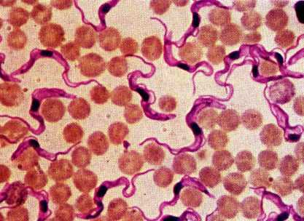
Trypanosomes
Protozoa (euglenozoa)
Extracellular blood borne pathogen
Flagellate
Exhibit one phase of
life cycle in a host, and
one in the vector

Slide 4
Background
Other names include
Nagana (in animals)
African Sleeping Sickness (in humans)
Animal African Trypanosomiasis (AAT)
Human African Trypanosomiasis (HAT)
T. rhodesiense (Trypanosoma brucei rhodesiense)
T. gambiense (Trypanosomoa brucei gambiense)
Responsible for 48,000 human deaths in 2008
HAT and AAT only present in Africa due to vector
Tsetse fly
USA cases only from recent Africa visitors contracting disease

Slide 5
Background
David Bruce: 1903
Nagana: horses and camels
Thought to have stopped the spread of Islam into Sub-Saharan Africa
Trypanosomes affect most African mammals
Humans, cattle, horses, sheep, donkeys, camels, pigs, dogs, and cats
T. rhodesiense: zoonotic
“Western African Sleeping Sickness”
More aggressive than eastern strain (T. gambiense)

Slide 6
Life Cycle
http://www.genomics.liv.ac.uk/tryps/trypsmovie.html

Slide 7
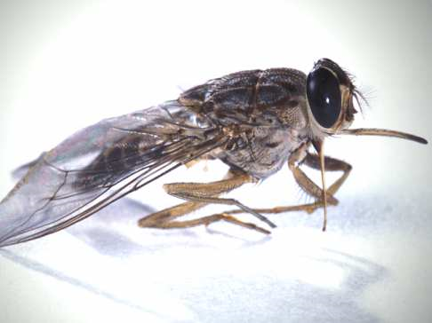
Tsetse Fly - vector
Unfed female
Fed female

Slide 8
Mechanics of HAT/AAT
Parasite enters the bloodstream → white blood cells attack.
Most parasites have the same variable surface glycoprotein (VSG),
Structure determines variable antigenic type (VAT).
These are destroyed by immune system
Remaining parasites with different VAT reproduce
Parasites: physically alter VAT to avoid destruction
Leads to long lasing infection
Nearly impossible for immune system to eradicate completely

Slide 9
Mechanics continued
During WBC response, proteolytic enzymes and toxins are produced
Destroys both protozoa and RBCs
→ anemia and drop in platelets
Prolonged anemia puts stress on the heart
Can lead to congestive heart failure

Slide 10
Symptoms in humans
Generally present 1-3 weeks after the initial infection. Include:
Anxiety
Drowsiness during the day
Fever
Headache
Insomnia at night
Mood changes
Sleepiness (may be uncontrollable)
Sweating
Swollen lymph nodes all over the body
Swollen, red, painful nodes at site of fly bite
Weakness

Slide 11
Animals affected

Slide 12
Symptoms in cattle
Anemia severity influenced by
age
breed
nutritional status
pathogen’s population virulence
Weakness
lethargy
loss of condition
(weight loss)
abortion
reduced milk production
small or weak calves
anemia
loss of fertility

Slide 13
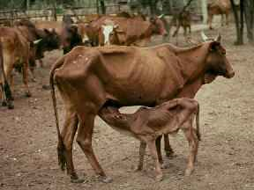
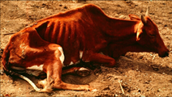

Slide 14
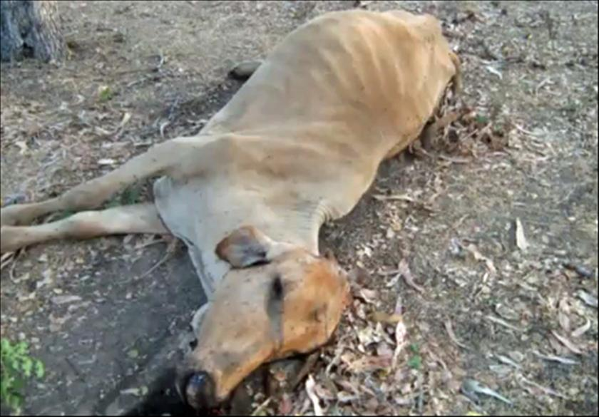
Symptoms cont.
Non-pathognomonic lesion occurs at the bite site
Chronic cases: most common cause of death is congestive heart failure
Prolonged anemia, myocardial damage, increased vascular permeability.

Slide 15
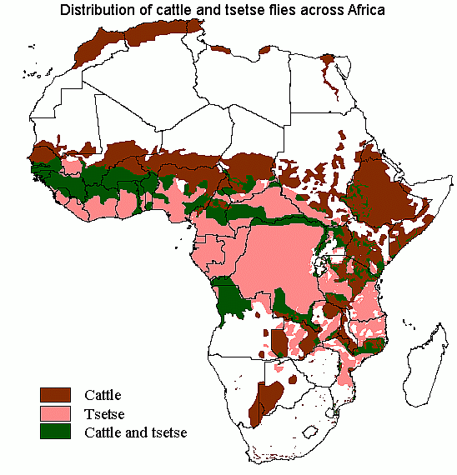
Geography

Slide 16
Socioeconomic Impact
Acute: death of cattle
Chronic: ↓ milk production, ↓ reproductive success (abortion or small, weak calves), and ↓ meat yield on butchered animals
↑ impact on farmers
Rely on cattle for income (milk sales, etc.)
Trypanosomiasis estimated cost: 1 - 4 billion USD/year to African farmers

Slide 17
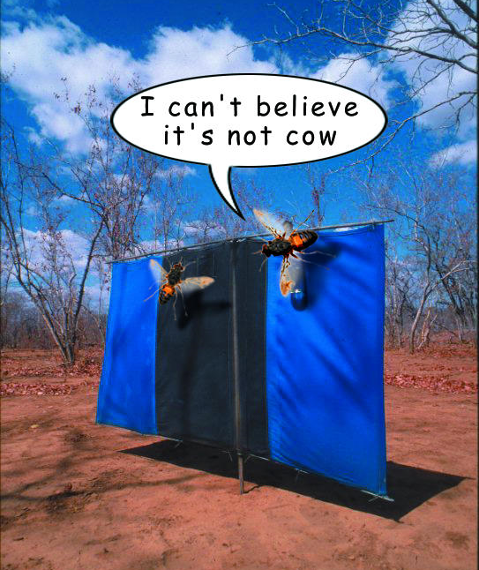
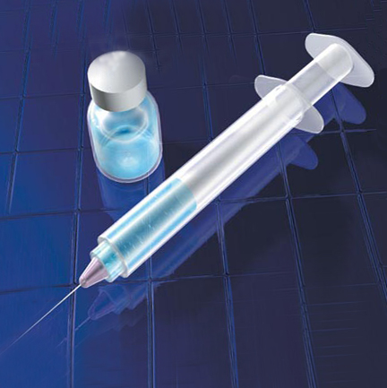
Prevention
Vaccines available
Unattainable in high-risk areas (low income)
Insect control

Slide 18
Management/treatment
Eflornithine (T. gambiense only)
Melarsoprol
Suramin (Antrypol)
Combination therapy
Pentamidine
Treats T. gambiense, but not T. rhodesiense
Toxic, so should not be used for prevention

Slide 19
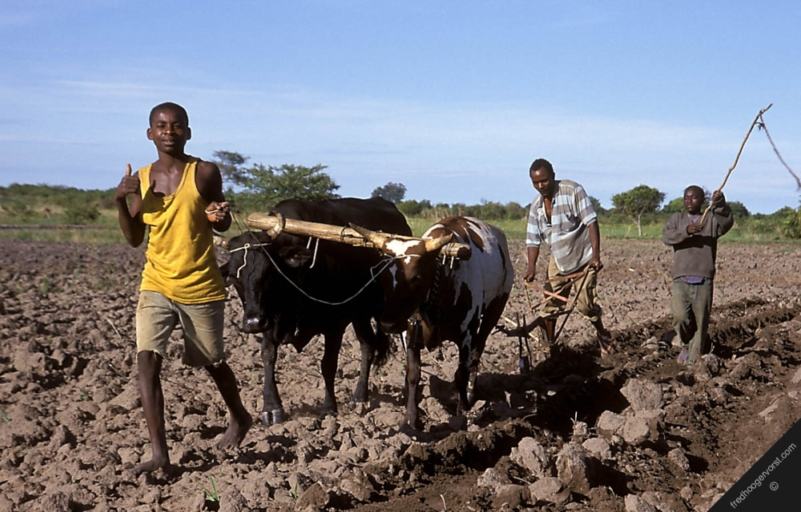
Case Study
Eco-social analysis of an East African agro-pastoral system: Management of tsetse and bovine trypanosomiasis
Johann Baumgartner, Gianni Gilioli, Getachew Tikubet, Andrew Paul Guiterrez

Slide 20
Hypotheses
↓ risk from tsetse and disease → ↑ cattle populations and their value
Interaction of ↓ risk and ↑ productivity → ↑ human and cattle populations,
Over exploitation of base resources (like pastures)
Lower environmental CC and ↓ sustainability
New social structures required to cope with consequences of this change

Slide 21
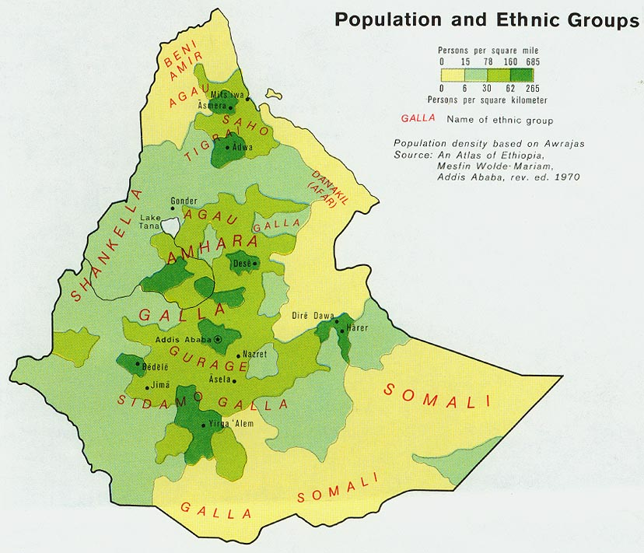
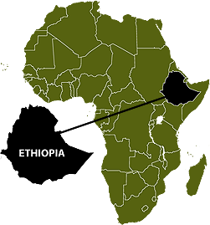
Methods
Study area
SW Ethiopia, village of roughly 254 households
“Extreme poverty” (UNSTATS 2006)
Productivity constraints
Tsetse and trypanosomiasis
Study from 1995 to 2005
Investigated
Insect control measures/livestock treatment
Insect trapping
Cattle blood testing/treatment

Slide 22
Methods cont.
Complex bio-economic model
Combined economic and biologic model
Incorporates: refuge, population demand, resource depletion, cattle and farmer dynamics (biological and economical)
Max-profit system (X_{c})
Unrestrained demand
Optimal long-term societal system (X*)
Sustainable
Determined economic impact and sustainability of control

Slide 23
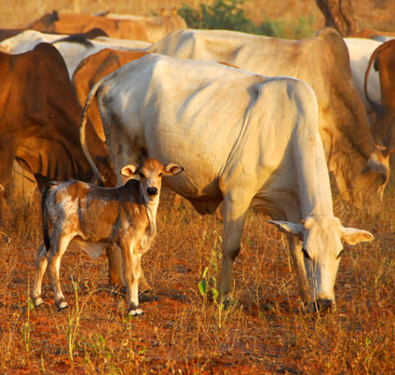
Results
During the 10-year period:
Disease prevalence ↓
29% - 10%
↓ Perceived Risk
Cattle numbers ↑: 574 - 2872
Calving rate ↑
0.068 - 0.56 calves·year⁻¹·cow⁻¹
Ethiopian highlands: no ↑ calving rate → tsetse control
Calf mortality substantially reduced
Milk production ↑: 0.1 - 1.31 liters/day

Slide 24
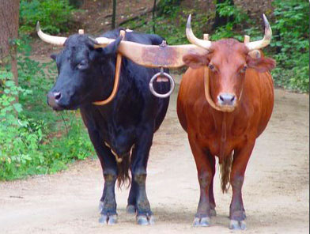
Results cont.
Draft oxen↑: 3 - 136
Cultivated area ↑
12 ha - 500 ha
33% ↓ in pasture area
440 ha - 295 ha → ↓ CC
Family size ↑: 3.5 - 5
Family income (in USD)/mo ↑: 15.6 - 60
Construction of a school in 2005
New road

Slide 25
Discussion
Neighboring villages experienced ↓ disease rate. No direct control measures taken
Spillover?
Tsetse population cycle?
Oxen productivity ↑
tsetse control
Land cultivated/ox ↑: 1 ha - 3.72 ha
Will short-term economic growth last?
This requires attention

Slide 26
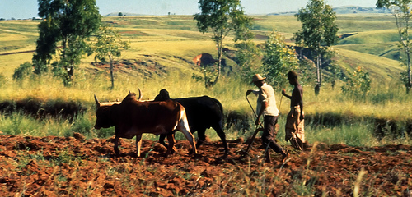
Conclusion
Must seek societal solutions
Post tsetse/trypanosomiasis suppression
farmers/govt.
establish stocking rates for cattle
encourage human reproductive health programs
Sustainable balance → long-term solution

Slide 27
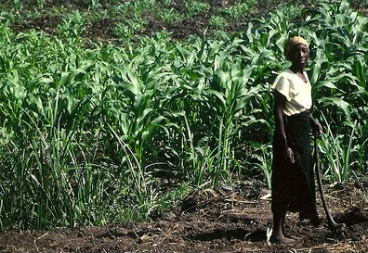
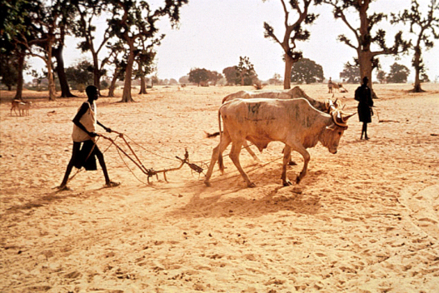
What’s next?
Continued insect control
Improved cattle breeds
N’dama cows: naturally resistant to trypanosomiasis
Ecologically sustainable farming

Slide 28
Lit. Cited
Baumgartner, J., G. Gilioli, G. Tikubet, A.P. Guiterrez. 2008. Eco-social analysis of an East African agro-pastoral system: Management of tsetse and bovine trypanosomiasis. Ecological Economics. 65: 125-135
Connor, R.J. 1994. The impact of Nagana. Journal of Veterinary Research. 61:379-383
David C. Dugdale, III, MD, Jatin M. Vyas, MD, PhD, David Zieve, MD, MHA, A.D.A.M. 2010. African trypanosomiasis. [online] Available from: http://www.ncbi.nlm.nih.gov/pubmedhealth/PMH0002338/. Accessed 3/20/2011.
Ferriman, A. Fake cows help to reduce sleeping sickness and use of insecticides. BMJ [Internet]. 2001 [cited 3-22-2011]; 29;323(7315): 711. Available from: https://www.ncbi.nlm.nih.gov/pmc/articles/PMC1121279/.
Krinski, W.L. 2009. Tsetse Flies (Glossinidae). Medical and Veterinary Entomology (2nd ed). 289-299
Snow, W.F. and P.F.L. Boreham. The feeding habits and ecology of the tsetse fly Glossina morsitans submorsitans Newstead in relation to Nagana transmission in The Gambia. Acta Tropica. 36:47-51
Taylor, K and E.M.L. Authié. 2005. Pathogenesis of Animal Trypanosomiasis. 331-353
Wells, E.A. 1972. The importance of mechanical transmission in the epidemiology of Nagana: A review. Trop. Anim. Hlth. Prod. 4: 74-88

Slide 29
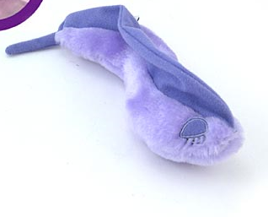
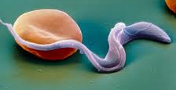
Questions?
Trypanosoma
Available in Plush!!!

